Slide 1
Fingering Suggestion Model for Piano Learning
24CS127 Presentation
CHOW, Man Hei Alvin
Notes:
Introduce yourself and the project title.

Slide 2
Table of Contents
01
02
Intro & Background
System Design & Methodology
03
Evaluation & Results
Why the project is proposed & How it solve existing problem
Current approaches & their limitations
04
Reflection & Future Work
How the project achieve the objectives
Potential future enhancements
Notes:
A brief overview of the presentation.

Slide 3
01
Intro & Background
Why the project is proposed

Slide 4
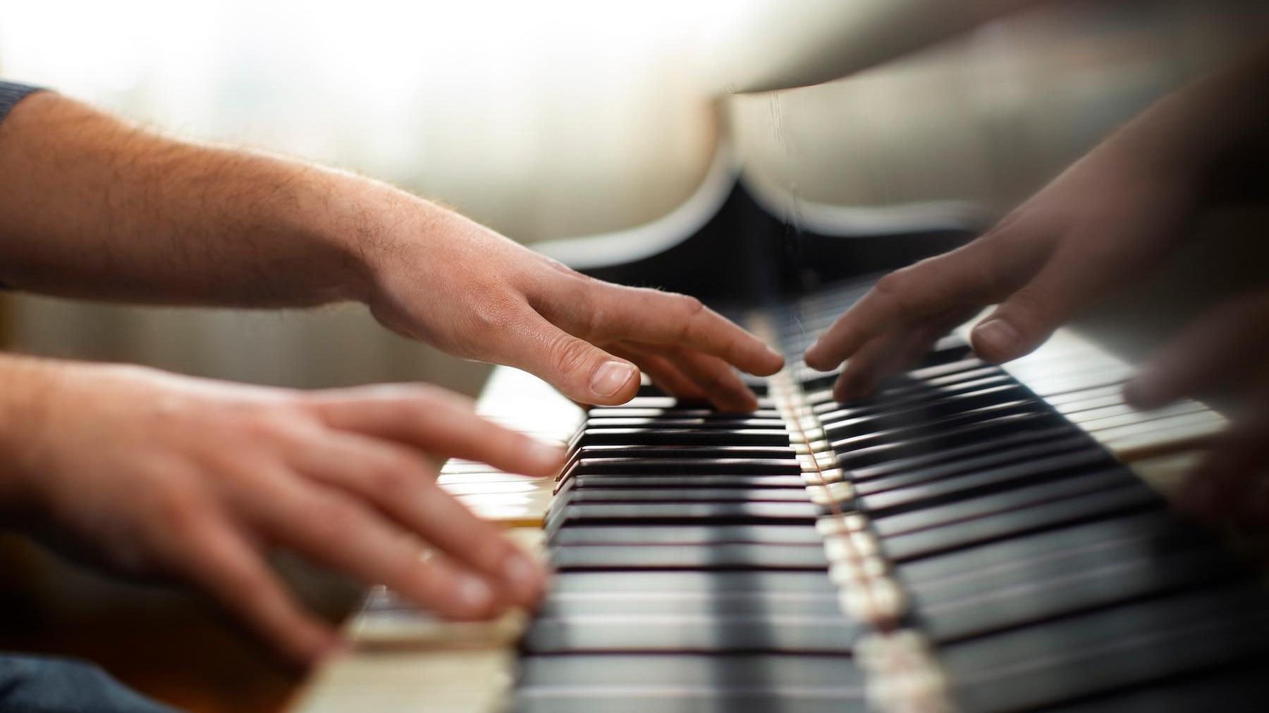
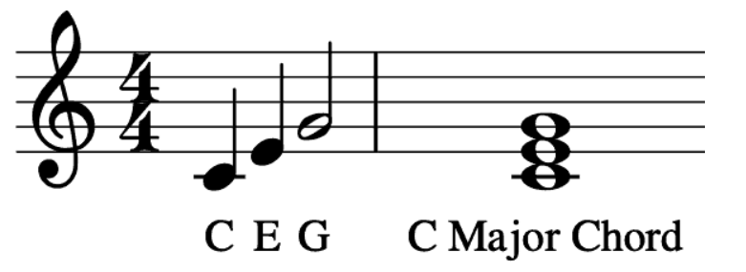
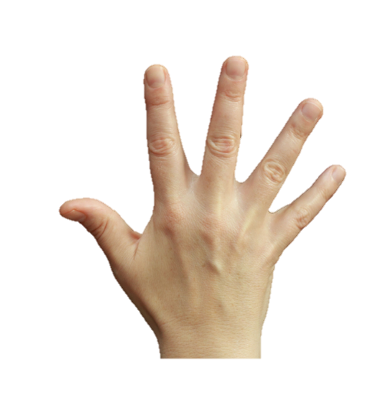
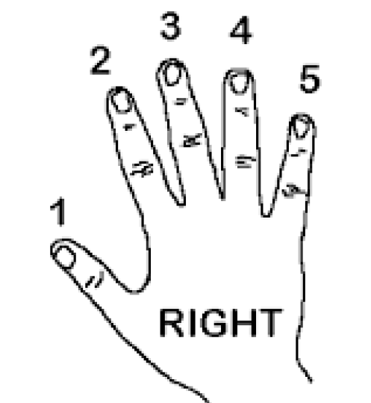
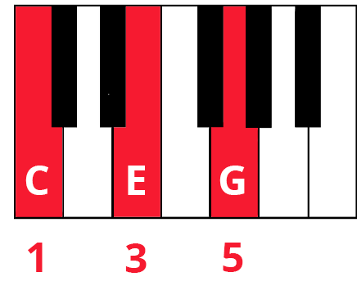
Easy Fingering Quiz (Right Hand)
i.e. 1 2/3 4/5
Notes:
Even if you don’t know how to play piano…
Can you guess which fingers could used to play? (Finger 1-5)

Slide 5
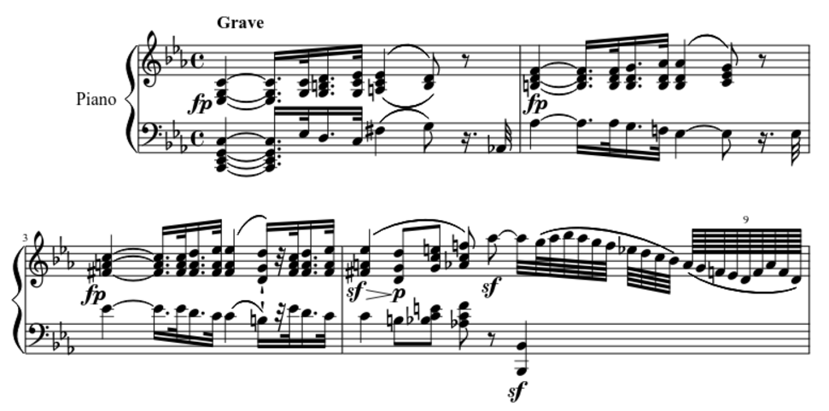

But… How about this?
?
Notes:
Longer and complex piece:
Way more difficult and unintuitive
This address the necessity of my project

Slide 6
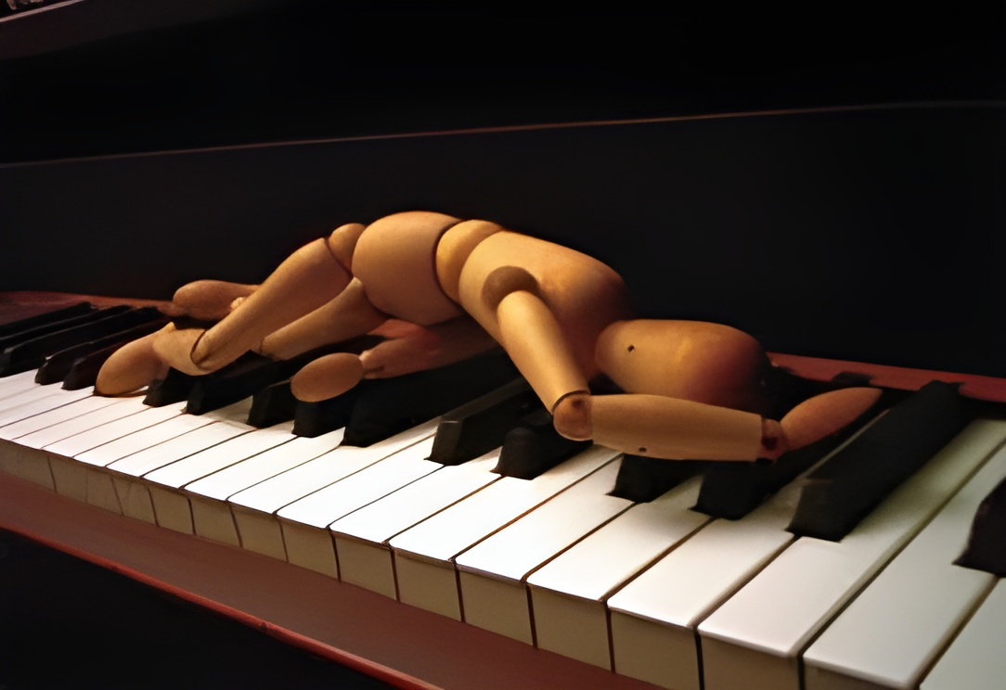

Why the project is proposed
Challenges for Beginners
Beginners might struggle with finger placement, leading to frustration.
Notes:
Mention the struggle of beginners with finger placement.

Slide 7
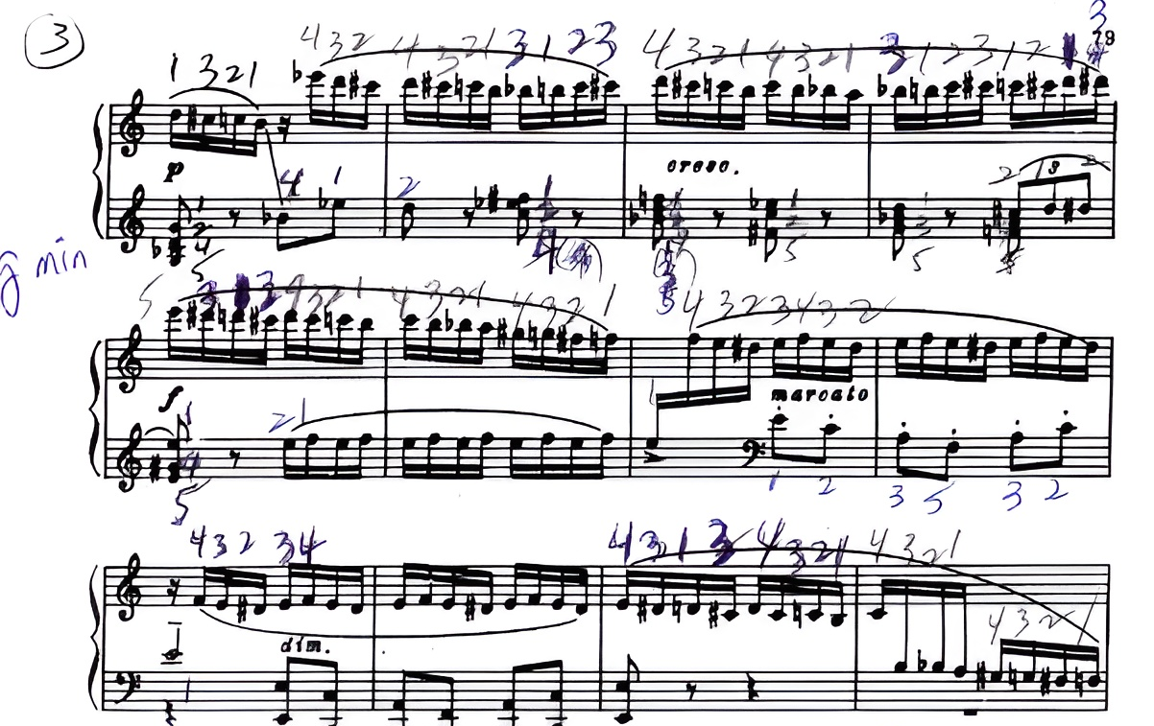

Why the project is proposed
Save Time for Manual Decision
Erase the need to annotate fingerings when learning new music pieces.
Notes:
Highlight the time-saving aspect.

Slide 8
02
System Design & Methodology
Current approaches & their limitations
Notes:
Currently, there are two main approaches to solving this problem…

Slide 9

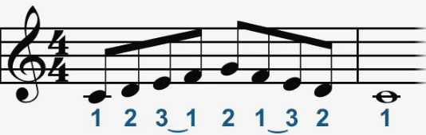
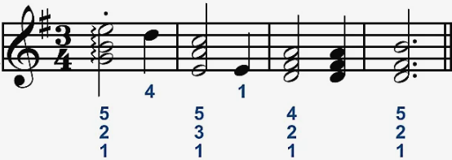
Current Approaches
Traditional Approach
Example 1: Specific Fingerings for Scales
Example 2: Consistent Fingerings for Chords
Rule-Based:
Rely on User-defined Rules designed by piano experts.
Notes:
Explain Rule-Based (consistent but inflexible).

Slide 10

Current Approaches
Machine Learning Approach
Observe finger-annotated scores
Learn Patterns
Suggest Fingerings
Data-Driven:
Adjust based on Observations from human-annotated pieces.
Notes:
Explain Machine Learning (adaptive to patterns of pianist behaviors).

Slide 11
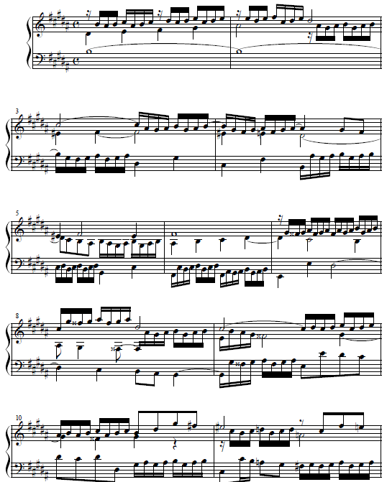
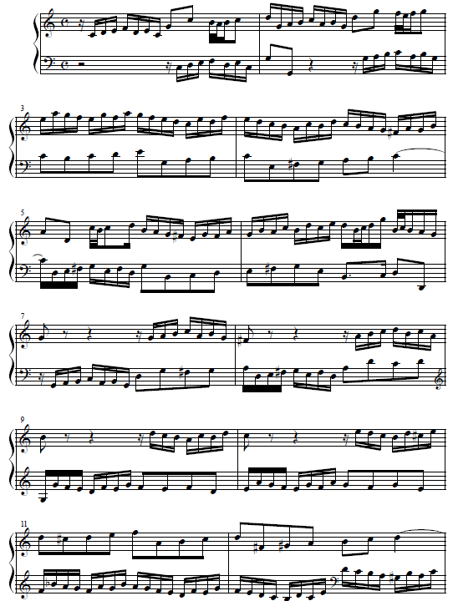
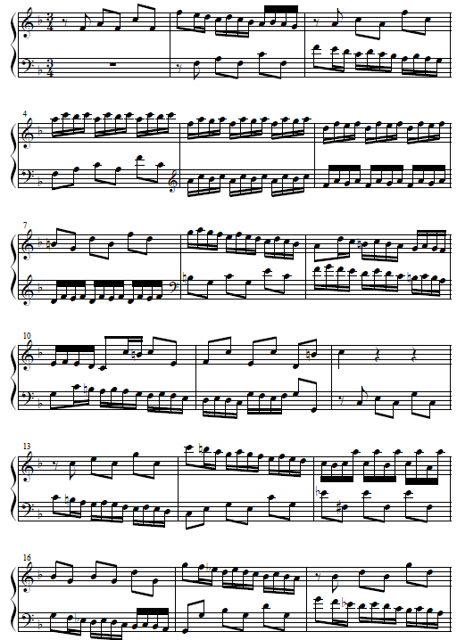
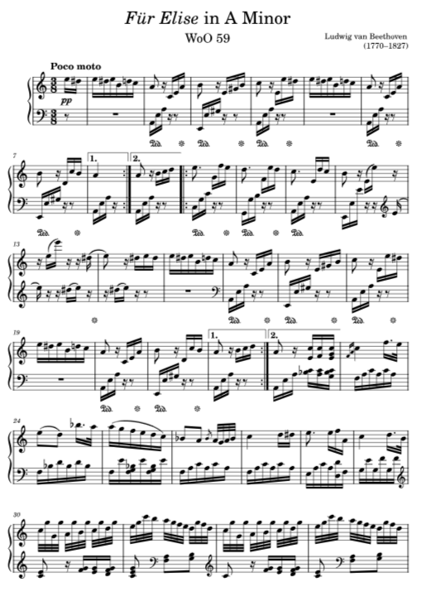

Data-Driven Approach: Hidden Markov Model (HMM)
01 Input Music Scores Dataset (PIG)
02 Training Train HMM to recognize finger patterns
03 Decoding Decode using Viterbi Algorithm
04 Output Suggest feasible fingerings to user
Input: Classical Music Scores (with Finger-Annotations)
A Textbook for the HMM model to learn from
HMM do not know what to learn from it yet!
Notes:
Step 1: Input music scores from the PIG dataset. (a piano fingering textbook for HMM)

Slide 12

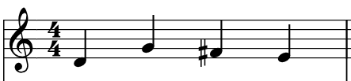
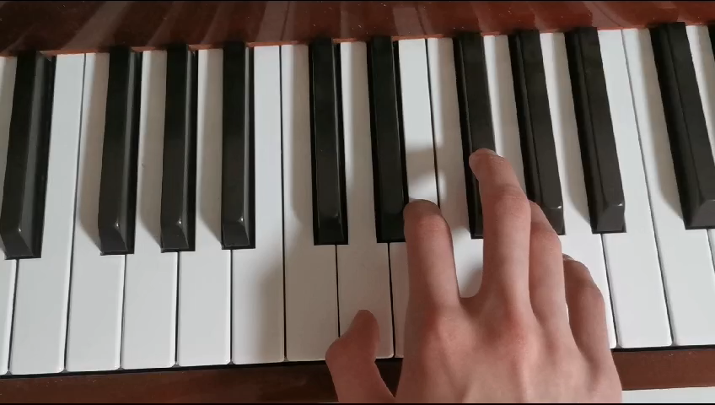
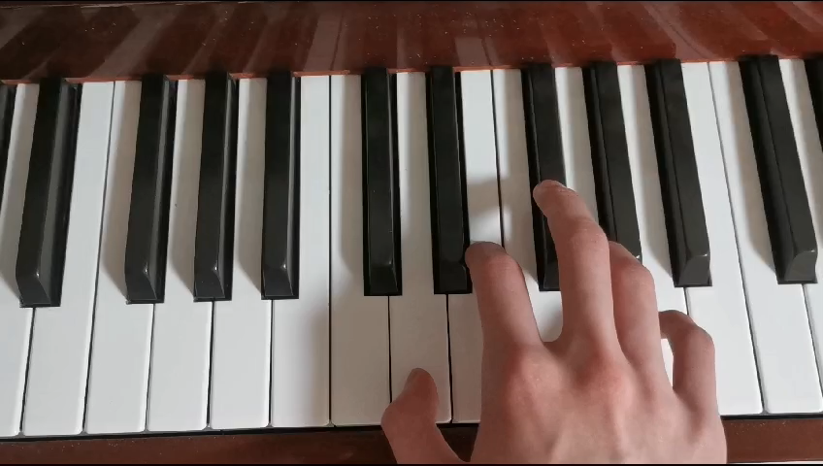
Data-Driven Approach: Hidden Markov Model (HMM)
01 Input Music Scores Dataset (PIG)
02 Training Train HMM to recognize finger patterns
03 Decoding Decode using Viterbi Algorithm
04 Output Suggest feasible fingerings to user
What HMM expected to learn from the dataset:
Feasible (higher prob.)
Unfeasible (lower prob.)
1 4 3 2
1 4 5 3
D G F# E
D G F# E
Visualize from the keyboard:
Don’t suggest
Expected Result: If observing note change: G (at 4th finger) → F# (at ?) Then, UNLIKELY to suggest F# (at 5th finger).
Instead, F# SHOULD result in max(next_finger) = 3.
Notes:
In this project, we expect HMM to suggest feasible fingerings by observing ground truth provided by professional pianists.
For a G→F♯ transition, the HMM should:
penalizes impractical fingerings (e.g., 4→5) &
prioritizes ergonomic choices (e.g., 4→3).

Slide 13
Data-Driven Approach: Hidden Markov Model (HMM)
01 Input Music Scores Dataset (PIG)
02 Training Train HMM to recognize finger patterns
03 Decoding Decode using Viterbi Algorithm
04 Output Suggest feasible fingerings to user
How can HMM act As we expected?
Major Problems to be addressed:
Role of HMM?
Definition of Status?
Definition of Observables?
Notes:
Show problems needed to be addressed.

Slide 14


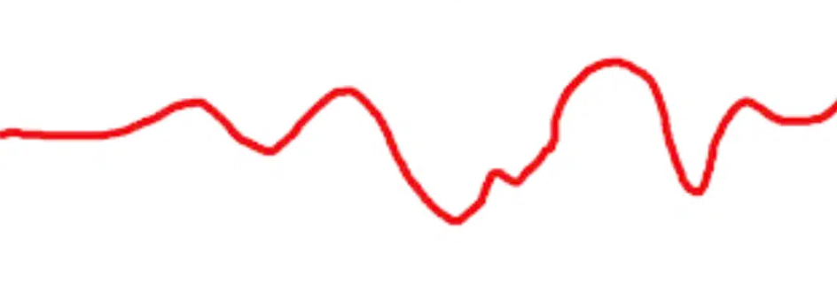

Data-Driven Approach: Hidden Markov Model (HMM)
01 Input Music Scores Dataset (PIG)
02 Training Train HMM to recognize finger patterns
03 Decoding Decode using Viterbi Algorithm
04 Output Suggest feasible fingerings to user
What is the Role of HMM?
1 single Model for both hands
Mixed Pattern:
2 HMMs for left & right hand separately
RH Pattern:
LH Pattern:
Notes:
Single HMM for both hands will confuse the fingering patterns of both hands and result in a disarray sequence.
RH & LH behave differently in Piano Fingering, so we use 2 HMMs to train separately.

Slide 15
Data-Driven Approach: Hidden Markov Model (HMM)
01 Input Music Scores Dataset (PIG)
02 Training Train HMM to recognize finger patterns
03 Decoding Decode using Viterbi Algorithm
04 Output Suggest feasible fingerings to user
What is the Definition of Status?
10 Fingers of both hands
5 Fingers of each hand
HMM-RH:
HMM-LH:
Most of the time…
i.e., Main Melody
(Lyric/Vocal)
i.e., Supporting Tune
(Harmony)
Notes:
As we mentioned, HMM in the Piano Fingering Problem is used to recognize the finger transition pattern of a single hand.
So, we don’t just use 10 fingers as status, but 5, considering a hand normally has 5 fingers.

Slide 16
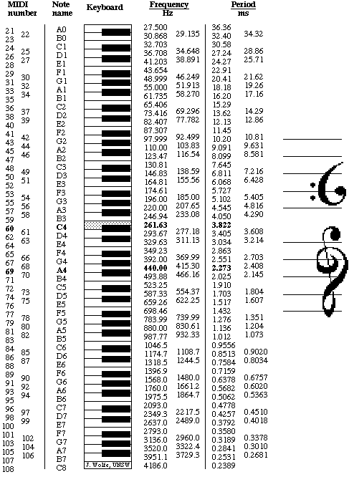
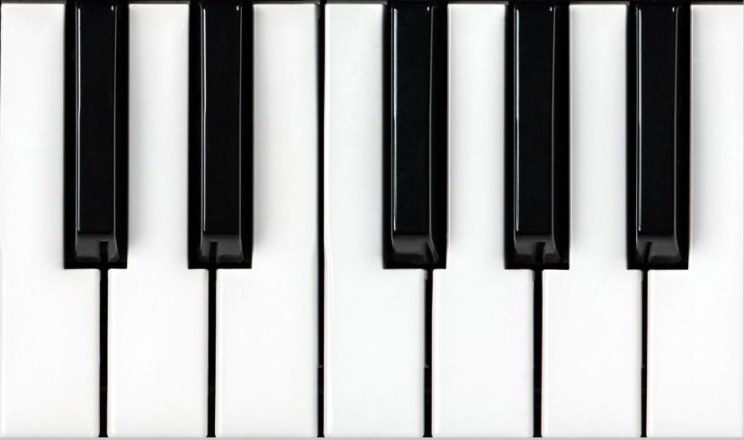
Data-Driven Approach: Hidden Markov Model (HMM)
01 Input Music Scores Dataset (PIG)
02 Training Train HMM to recognize finger patterns
03 Decoding Decode using Viterbi Algorithm
04 Output Suggest feasible fingerings to user
How should we define Observables?
Absolute Pitch, like MIDI values
Consider white & black (W/B) keys separately
A#
(Bb)
Example: Note Transition: E → A#/Bb
MIDI distance: 6 semitones
W/B distance: 3W, 1B
To fit the musical context better for later constraint
E
Notes:
MIDI uses an absolute pitch that treats all piano keys' distance evenly, which is not suitable for constraint and lost interpretation.
So, I reconsider the white & black keys separately and compute their distance separately.
IF asked “flat” and “sharp”:
All flats are converted into the equivalent sharp form of the previous white keynote (Eb to D#) for more straightforward computation.

Slide 17
Data-Driven Approach: Hidden Markov Model (HMM)
01 Input Music Scores Dataset (PIG)
02 Training Train HMM to recognize finger patterns
03 Decoding Decode using Viterbi Algorithm
04 Output Suggest feasible fingerings to user
Transition Matrix in Piano Fingerings
From\To | To 1st Finger | To 2nd Finger | To 3rd Finger | To 4th Finger | To 5th Finger
From 1st Finger | p(1,1) | p(1,2) | p(1,3) | p(1,4) | p(1,5)
From 2nd Finger | p(2,1) | p(2,2) | p(2,3) | p(2,4) | p(2,5)
From 3rd Finger | p(3,1) | p(3,2) | p(3,3) | p(3,4) | p(3,5)
From 4th Finger | p(4,1) | p(4,2) | p(4,3) | p(4,4) | p(4,5)
From 5th Finger | p(5,1) | p(5,2) | p(5,3) | p(5,4) | p(5,5)

Slide 18
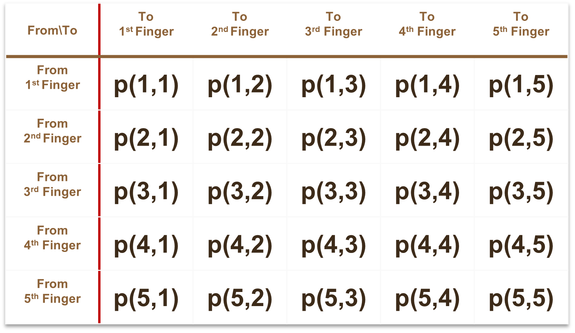
Data-Driven Approach: Hidden Markov Model (HMM)
01 Input Music Scores Dataset (PIG)
02 Training Train HMM to recognize finger patterns
03 Decoding Decode using Viterbi Algorithm
04 Output Suggest feasible fingerings to user
Emission Matrices in Piano Fingerings
Observation | (-12W, -1B) | (-12W, -1B) | … | (12W, 1B) | (12W, 1B)
An emission dictionary that… Key: Observable (W, B) Value: 5*5 emission matrix
Notes:
Similar to transition matrix, emission matrices are finger matrices that based on each observation of pitch changes (W/B keys distance)

Slide 19
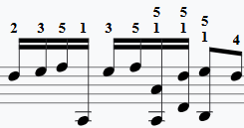
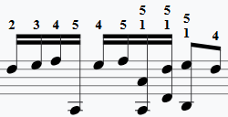


Data-Driven Approach: Hidden Markov Model (HMM)
01 Input Music Scores Dataset (PIG)
02 Training Train HMM to recognize finger patterns
03 Decoding Decode using Viterbi Algorithm
04 Output Suggest feasible fingerings to user
Controlling size of observations… Why?
Observation | (-12W, -1B) | (-12W, -1B) | … | (12W, 1B) | (12W, 1B)
To avoid unfeasible fingers for long intervals
Encourage using finger 1→5 for large intervals/leaping!
Large white key distance may read outliers (i.e., hand repositioning)
Notes:
Also, this project adds a global variable to constrain the range of distance that is being considered in the emission building.
Why?
By considering all possible pitch distances before, I get an unfeasible finger suggestion for large intervals of white keys.
This is caused by a very long range of pitch changes that often involve hand-repositioning behaviors
Make the model read and consider outliers that hurt generalization.
After tuning the max range value again and again, I set the final value as 12 white key distance.
Because I start to see consistent 1&5 finger suggestions for these leap patterns.

Slide 20
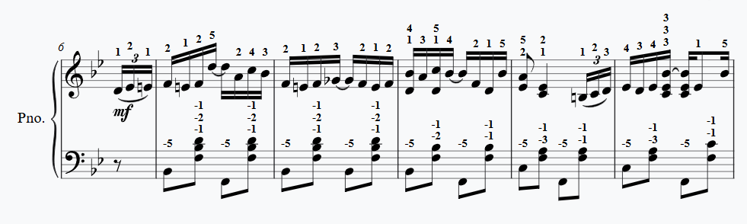
Data-Driven Approach: Hidden Markov Model (HMM)
01 Input Music Scores Dataset (PIG)
03 Decoding Decode using Viterbi Algorithm
04 Output Suggest feasible fingerings to user
02 Training Train HMM to recognize finger patterns
Chord Handling
Impossible fingering on multi-notes
Is the HMM not capturing Chord patterns from the dataset…?
Notes:
Another problem I encountered that resulted in bad fingerings was that:
The model failed to handle feasible fingers for chords
Here, Chords are the multiple notes that need to be played at a time. (like these three notes)
Problem
The model suggests using the same finger for multiple notes at a time, which is impossible.
Throw Question: Does the HMM not capture chord fingering patterns?

Slide 21

Data-Driven Approach: Hidden Markov Model (HMM)
01 Input Music Scores Dataset (PIG)
03 Decoding Decode using Viterbi Algorithm
04 Output Suggest feasible fingerings to user
02 Training Train HMM to recognize finger patterns
Chord Handling
Impossible fingering on multi-notes
Chord patterns recognized from the dataset
Too much noise data (dirt) covering the actual underlying pattern!
Notes:
After making sure the fingering dataset that I trained from do contains Chord sequences:
I started searching for the problem and have located what happened.
Explain the analogy

Slide 22
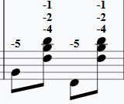
Data-Driven Approach: Hidden Markov Model (HMM)
01 Input Music Scores Dataset (PIG)
03 Decoding Decode using Viterbi Algorithm
04 Output Suggest feasible fingerings to user
02 Training Train HMM to recognize finger patterns
Chord Handling by penalty
How are multi-notes present sequentially?
Example of Left Hand (ascending notes: F, B, D):
These 3 notes are represented in sequence: 4, 2, 1
We should penalize the probability for all ascending sequences
Penalize the probability, including:
i.e., p(1,4), p(1,3), p(1,2).
D
B
F
This lets the recognized Chord patterns appear
Notes:
To remove the noisy data that covers the underlying Chord patterns:
I use penalty as the digger
But first, how are Chord data recorded in sequential data?
Show LH Example, notes are from bottom-to-top; fingers also bottom-to-top.
This means Chords in LH are always in a descending fingerings.
Penalize all ascending finger transitions when the time difference of these notes is ~0 (chords/very fast transition)

Slide 23
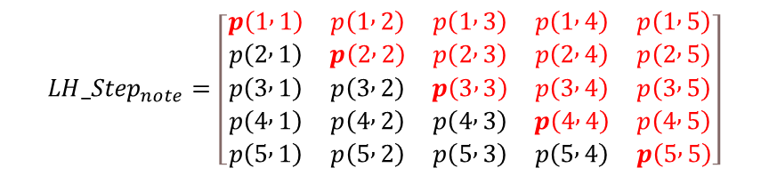
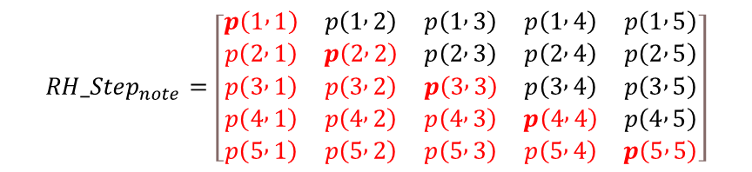
Data-Driven Approach: Hidden Markov Model (HMM)
01 Input Music Scores Dataset (PIG)
03 Decoding Decode using Viterbi Algorithm
04 Output Suggest feasible fingerings to user
02 Training Train HMM to recognize finger patterns
Chord Handling
Penalty on Left/Right Hand’s fingerings
$${LH_Step}_{note}=\left[\begin{matrix}p\left(1 , 1\right) & p\left(1 , 2\right) & p\left(1 , 3\right) & p\left(1 , 4\right) & p\left(1 , 5\right) \\ p\left(2 , 1\right) & p\left(2 , 2\right) & p\left(2 , 3\right) & p\left(2 , 4\right) & p\left(2 , 5\right) \\ p\left(3 , 1\right) & p\left(3 , 2\right) & p\left(3 , 3\right) & p\left(3 , 4\right) & p\left(3 , 5\right) \\ p\left(4 , 1\right) & p\left(4 , 2\right) & p\left(4 , 3\right) & p\left(4 , 4\right) & p\left(4 , 5\right) \\ p\left(5 , 1\right) & p\left(5 , 2\right) & p\left(5 , 3\right) & p\left(5 , 4\right) & p\left(5 , 5\right)\end{matrix}\right]$$
$${RH_Step}_{note}=\left[\begin{matrix}p\left(1 , 1\right) & p\left(1 , 2\right) & p\left(1 , 3\right) & p\left(1 , 4\right) & p\left(1 , 5\right) \\ p\left(2 , 1\right) & p\left(2 , 2\right) & p\left(2 , 3\right) & p\left(2 , 4\right) & p\left(2 , 5\right) \\ p\left(3 , 1\right) & p\left(3 , 2\right) & p\left(3 , 3\right) & p\left(3 , 4\right) & p\left(3 , 5\right) \\ p\left(4 , 1\right) & p\left(4 , 2\right) & p\left(4 , 3\right) & p\left(4 , 4\right) & p\left(4 , 5\right) \\ p\left(5 , 1\right) & p\left(5 , 2\right) & p\left(5 , 3\right) & p\left(5 , 4\right) & p\left(5 , 5\right)\end{matrix}\right]$$
Notes:
LH: penalize ascending finger transitions, as we mentioned. (shown as a red upper triangle)
RH: Like the idea for LH, penalize all descending transitions. (shown as a red lower triangle)

Slide 24
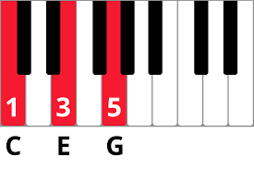
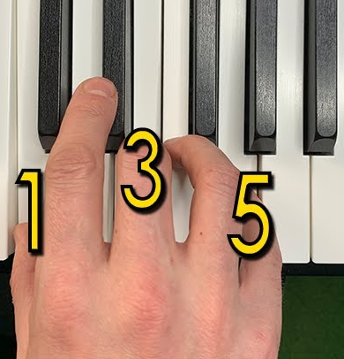
Data-Driven Approach: Hidden Markov Model (HMM)
01 Input Music Scores Dataset (PIG)
02 Training Train HMM to recognize finger patterns
04 Output Suggest feasible fingerings to user
03 Decoding Decode using Viterbi Algorithm
Expected Output from HMM:
1 3 5
5 3 1
Visualize from the keyboard:
Notes:
After handling all special cases we addressed:
The model is ready for predicting feasible fingerings.
Show Example above
Now, consider the end-users of this project are piano learners/pianists
They may not have much technical background
Need intuitive UI!

Slide 25
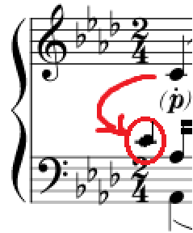
User Interface for HMM: Piano Fingering Advisor UI
To fully automatic process fingerings…
New Challenge: How do you decide which notes are for which hands?
We trained 2 HMMs for the left & right hand but did not solve hand assignments...
Previous Approaches that failed:
A: Clustering by pitch distance
In this counter case, the right-hand note is located closer to the left-hand notes
Notes:
I want to make a UI that automatically suggests all fingerings to a fully unannotated music sheet:
So, users required only minimum effort to utilize this software.
But New Challenge!
We trained 2 HMMs for each LH/RH. But there’s no system to tell what notes should be played by Left/Right Hand…
Tried different approach. Show example…

Slide 26
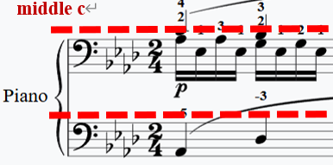
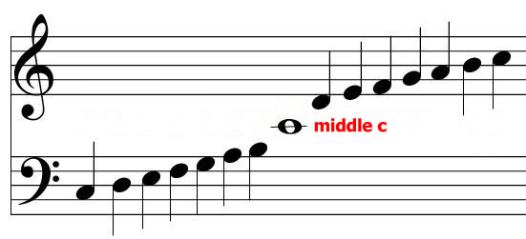
User Interface for HMM: Piano Fingering Advisor UI
To fully automatic process fingerings…
New Challenge: How do you decide which notes are for which hands?
We trained 2 HMMs for the left & right hand but did not solve hand assignments...
Previous Approaches that failed:
B: Split by Middle C (C4)
In this counter case, notes of both hands are below middle C.
Notes:
Tried another approach. Show example…

Slide 27
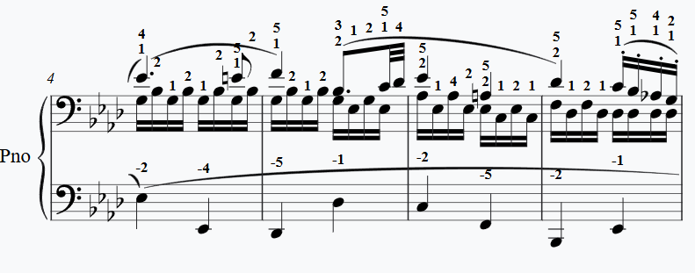
User Interface for HMM: Piano Fingering Advisor UI
To fully automatic process fingerings…
Solution: Decide Hands by Part
Part 0: Right Hand
Part 1: Left Hand
Limitation: Heavily depends on note arrangement
Notes:
Settle on the last approach. Show example…
Upper: RH
Lower: LH
Limitation
It highly relies on the arrangement of the notes.
I use this as the final solution because… Generally, editors arrange the upper part for RH and the lower part for LH.
But for a few cases (especially advanced piano pieces)
Editor arranges music parts by music layer (i.e. melodies, lyrics)
Some upper parts may contain notes that are supposed to be played by LH…

Slide 28
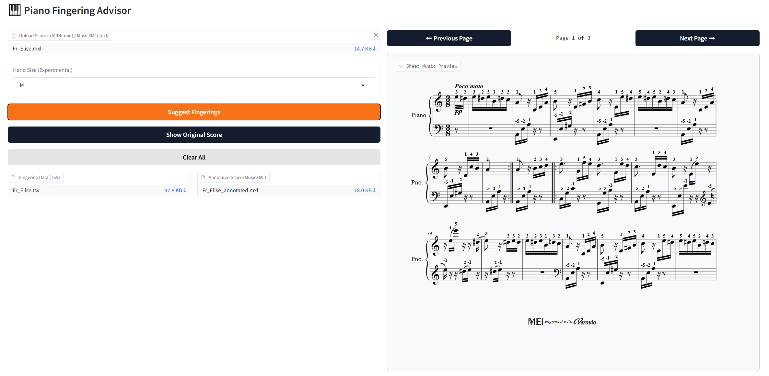
User Interface for HMM: Piano Fingering Advisor UI
Notes:
Show UI

Slide 29
Evaluation & Results
03
How the project achieve the objectives

Slide 30
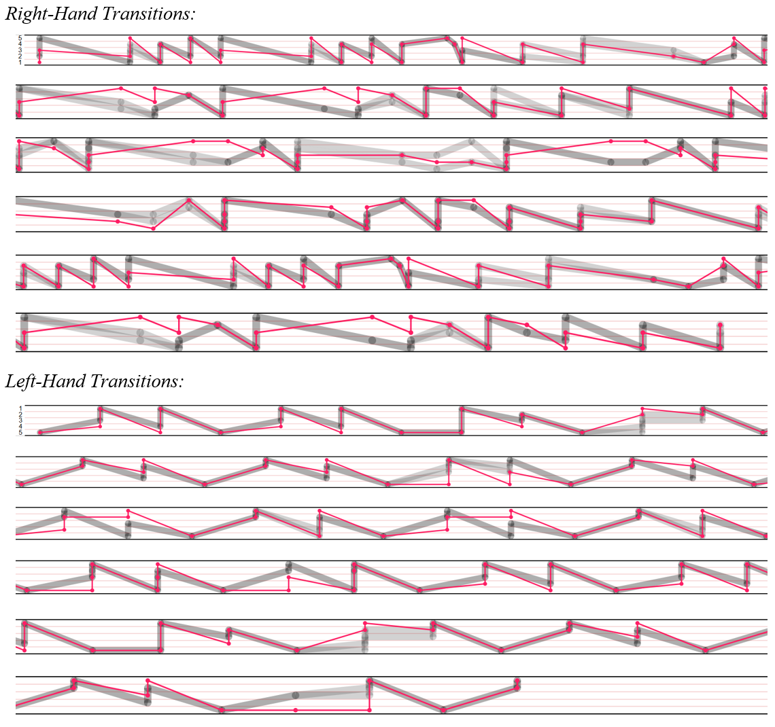
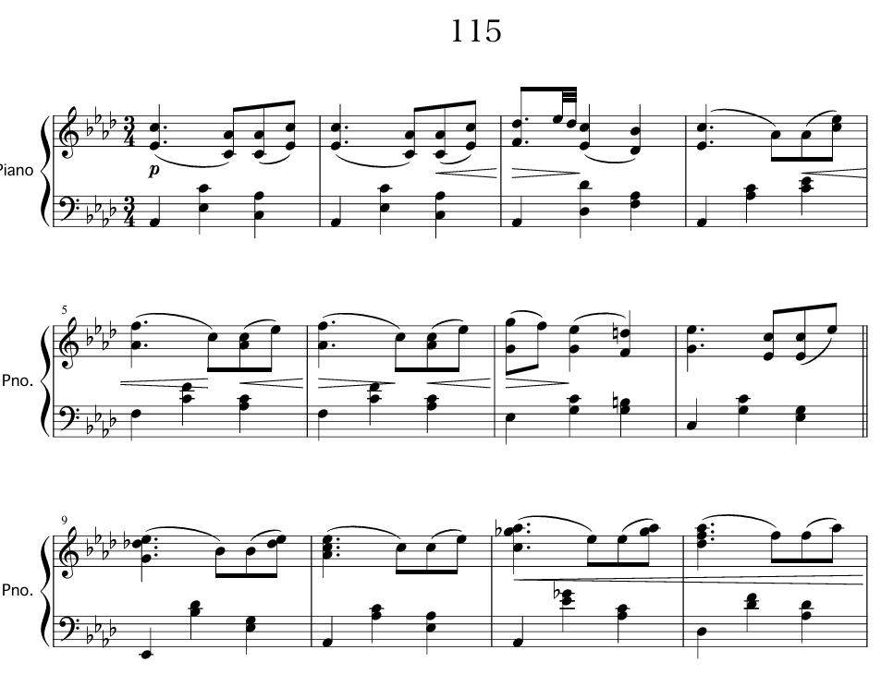
Quantitative Evaluation: PIG Piano Fingering Visualizer
How aligned are the suggested and actual fingerings?
Notes:
PIG Visualizer from the official dataset that I used for training in this project.
Shows matches and alignments of predicted fingerings and ground truth fingerings, visually.
Test piece 115 shows a satisfying match and alignment.
In piano fingering, we don’t have some things so-called “Modal Answer/Standard Answer”.
Considering its sequential nature, we can evaluate it by aligning the direction of ground truth/predictions…
Hard to quantify an overall performance by PIG Visualizer.
I created another metric to compute alignment score.

Slide 31
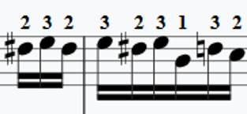
Quantitative Evaluation: Alignment Score
To quantify equivalent fingerings for directional sequences
My Approach: Determine finger direction by window size of 3
Right-Hand Transition (Example) 1→3→4 is “Ascending” 5→2→1 is “Descending” 1→3→2 is “Neutral” | Left-Hand Transition (Example) 1→2→4 is “Descending” 5→3→1 is “Ascending” 2→4→2 is “Neutral”
Limitation: Could only reflect the feasibility of directional sequences
Feasibility of Neutral Direction remains unknown
Notes:
Determine the direction of finger transitions, by a window size of 3:
- Minimum length for defining as direction.
Show examples
Limitation
Alignment cannot represent the finger feasibility of iterative note sequence. (Only quantify direction)

Slide 32
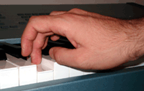
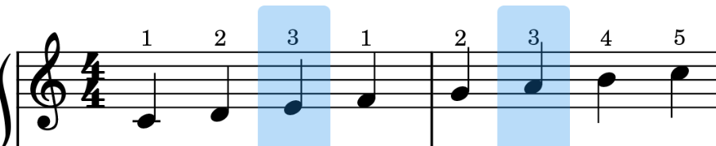
Quantitative Evaluation: Alignment Score
To quantify equivalent fingerings for directional sequences
My Approach: Determine finger direction by window size of 3
Special Cases: Thumb-under Transition
Example of Right-Hand
2→3→1 is “Ascending” IFF
White Key distance from 3→1 is ≤ 2
The piano key of finger 1 is not a black key
Visualization of the
Thumb-under technique
Notes:
There’s also a special case I considered during computing the count of alignment…
Common Piano Fingering Skill: Thumb-under Transition
In note sequences with >5 lengths (like 7 or 10 notes), we can’t just use 12345 for ascending. We have 5 fingers!
Explain this Intermediate transition technique…
Also, consider this when computing direction.

Slide 33
Quantitative Evaluation: Alignment Score
To quantify equivalent fingerings for directional sequences
Overall Evaluation on the PIG dataset
Match Accuracy does not reflect all fingers’ feasibility
[Evaluation Summary for M] Average Match Accuracy across all tests: 49.82% Average Max Consecutive Match rate across all tests: 11.376% Average Max Consecutive Mismatch rate across all tests: 10.426% Average Alignment of Ground Truth across all tests: 78.232%
High Alignment: HMM has captured underlying patterns
Notes:
Explain Result

Slide 34
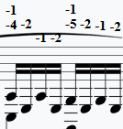
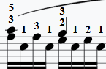
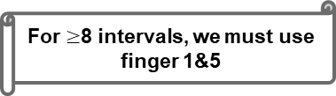
Qualitative Evaluation: Professional Pianist Feedback
For $≥$8 intervals, we must use finger 1&5
Margaret To, from GMC Music:
Strength
“Feasible for beginners, mirrors standard practices. “
For 3 intervals, we generally use 1&3, 2&4, or 3&5
Weakness
“Unoptimized for octaves/chords in advanced pieces.”
Key Insight
“Works best for monophonic sequences; struggles with polyphony due to Markov assumption.”
Notes:
Explain Results

Slide 35
Reflection & Future Work
04
Potential future enhancements
Notes:
To wrap up, this project also has exciting possibilities for the future

Slide 36


Reflection: Failed Hand-Size Adaptation
Bias of PIG Dataset
Validity of Problem
The dataset used in this project only contains fingerings for average pianists.
Verify earlier with a professional piano teacher about whether fingerings varied for adults and children.
Notes:
But first, I actually have a failed approach in this project due to my oversight when addressing the problem.
Explain what caused the problem

Slide 37


Future Enhancements
Real-Time Suggestion
Integrating Music Education
Hybrid Model with LSTM
Suggests subsequent finger placement in real-time by capturing hand motions.
Integrate LSTM to capture long-term dependencies and address first-order HMM's lack of memory.
Seeks opportunities to integrate the project into the music education system.
Notes:
Real-time fingering suggestions
Possibilities to suggest a finger by considering the last position from the user?
Idea:
The user does not need to follow the suggested finger!
Instead, the Model suggests an adaptive finger on the user's last finger decision.
Hybrid Model w/ LSTM
Integrate with LSTM to overcome the limited memory of first-order HMM.
Expand into a broader learning platform.

Slide 38
Conclusion
List of Achievements:
Built a functional HMM system for piano fingering with >70% alignment to human experts.
Designed an intuitive UI for MIDI/MusicXML integration.
Impact:
Assists in music education and reduces student/teacher workload.
Notes:
To conclude my project…
Show list of achievements & how it help people

Slide 39
Empowering every Piano student…
With confidence to learn & play!
Notes:
I hope to empower every piano student…
- With confidence to learn and play.

Slide 40
Thank You
Time for Questions!
Notes:
Thank the audience.
I will be happy to answer any questions about this project!

Slide 41
References
Clarke, E., Parncutt, R., Raekallio, M., & Sloboda, J. (1997). Talking fingers: An interview study of pianists' views on fingering. Musicae Scientiae, 1(1), 87-107. https://doi.org/10.1177/102986499700100106
Bernays, M., & Traube, C. (2013). Expressive production of piano timbre: Touch and playing techniques for timbre control in piano performance. Proceedings of the Sound and Music Computing Conference. https://doi.org/10.5281/ZENODO.850270
Gao, W., Zhang, S., Zhang, N., Xiong, X., Shi, Z., & Sun, K. (2023). Generating fingerings for piano music with model-based reinforcement learning. Applied Sciences, 13(20), 11321. https://doi.org/10.3390/app132011321
Gan, Q., Wang, S., Wu, S., & Zhu, J. (2024). PianoMotion10M: Dataset and Benchmark for Hand Motion Generation in Piano Performance. ArXiv, abs/2406.09326.
Aquino, J., Chudinov, P., & Sahnoun, M. (2022, October 4). An AI-based method for student piano performance assessment. Launchpad.ai | AI and Data Science for Brands. https://www.launchpad.ai/blog/an-ai-based-method-for-student-piano-performance-assessment
Nakamura, E., Ono, N., & Sagayama, S. (2014). Merged-Output HMM for Piano Fingering of Both Hands. International Society for Music Information Retrieval Conference.
Nakamura, E., Saito, Y., & Yoshii, K. (2020). Statistical Learning and Estimation of Piano Fingering. ArXiv, abs/1904.10237.
Guan, X., Zhao, H., & Li, Q. (2022). Estimation of playable piano fingering by pitch-difference fingering match model. EURASIP Journal on Audio, Speech, and Music Processing, 2022(1). https://doi.org/10.1186/s13636-022-00237-8
Ramoneda, P., Miron, M., & Serra, X. (2021). Piano Fingering with Reinforcement Learning. ArXiv, abs/2111.08009.
Iman, A. P., & Ahn, C. W. (2024). A model-free deep reinforcement learning approach to piano fingering generation. 2024 IEEE Conference on Artificial Intelligence (CAI), 4, 31-37. https://doi.org/10.1109/cai59869.2024.00016
Rawat, P., Bajaj, M., Vats, S., & Sharma, V. (2023). A comprehensive study based on MFCC and spectrogram for audio classification. Journal of Information and Optimization Sciences, 44(6), 1057-1074. https://doi.org/10.47974/jios-1431
Yonebayashi, Y., Kameoka, H., & Sagayama, S. (2007). Automatic Decision of Piano Fingering Based on Hidden Markov Models. International Joint Conference on Artificial Intelligence.

